Slide 1
Bring Back the Pollinators
ADD NAME
ADD AFFILIATION
Notes:
This template presentation provides an overview of native bees, the threats they face, and what we can each do to support them. Feel free to use this presentation however you would like. You’re welcome to add to it or remove slides that aren’t relevant to your presentation. Enjoy!

Slide 2
The Xerces Society
For Invertebrate Conservation
Protecting the life that sustains us
Since 1971, the Xerces Society has worked to protect wildlife through the conservation of invertebrates and their habitat.
Photo: Endangered Fender’s blue butterfly (Icaricia icarioides fenderi) by Dana Ross
Notes:
Since 1971, the Xerces Society has worked to protect wildlife through the conservation of invertebrates and their habitat.
The Xerces Society is named for the Xerces blue butterfly (Glaucopsyche xerces) which was the first U.S. butterfly to go extinct due to human activities.

Slide 3
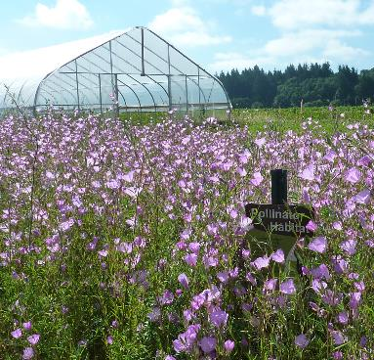
Protecting the Life That Sustains Us
Conservation
Advocacy
Research
Education
Photos: Paul Jepson; Dick Dewey; Xerces Society/Brianna Borders
Notes:
The Xerces Society uses a range of approaches to protect invertebrates including conservation, advocacy, research, and education.

Slide 4
Bee City USA
Bringing Communities Together to Sustain Pollinators
Since 2012, Bee City USA has work to galvanize communities to sustain pollinators, in particular the more than 3,600 species of native bees in this country, by increasing the abundance of native plants, providing nest sites, and reducing the use of pesticides.
Photo: Endangered Fender’s blue butterfly (Icaricia icarioides fenderi) by Dana Ross
Notes:
Bee City USA and Bee Campus USA, Initiatives of the Xerces Society, bring communities together to sustain pollinators.
Since 2012, Bee City USA has worked to galvanize communities to sustain pollinators, in particular the more than 3,600 species of native bees in this country, by increasing the abundance of native plants, providing nest sites, and reducing the use of pesticides.

Slide 5
Why Invertebrates?
“The fate of the world’s insects is inseparable from our own”
Decomposition
Biocontrol
Base of the Food Chain
Pollination
Photos: Marc Barrison; Debbie Roos; The-Gecko, Flickr; Rollin Coville
Sources: McIntyre 2000; NC State Unviersity 2006; New York Times 2017
Notes:
DEFINE INVERTEBRATE. Any animal lacking a backbone. Includes multiple classes of animals from insects to crustaceans.
Invertebrates play crucial roles for our survival including helping break down organic matter, keeping pest populations in check, serving as food (base of the food chain), and pollinating crops and wild flowers. Invertebrates account for over 95% of animal biodiversity on the planet. Most research on arthropods in urban areas has been on pest control and epidemiology (McIntrye 2000) which is out of proportion since only about 1% of insects are ‘pests’ (NC State University 2006).
Sources:
The Editorial Board. 2017. Insect Armageddon. The New York Times. Available: https://www.nytimes.com/2017/10/29/opinion/insect-armageddon-ecosystem-.html
McIntrye. N.E. 2000. Ecology of urban arthropods: a review and a call to action. Annals of the Entomological Society of America. 93:825-835.
NC State University. 2006. Chapter 18: Insects as pests. Available: https://projects.ncsu.edu/cals/course/ent425/text18/pestintro.html

Slide 6
Pollination 101
Photo: Sarah Greenleaf
Notes:
Pollination is the transfer of pollen grains from the stamen (anther) of a flower to the female pistil (stigma). Flowers rely on wind, water, insects, birds, and bats. Yes, bats! Mostly tropical crops like chocolate and bananas.

Slide 7
Why Care About Pollinators?
Photo: Clay Bolt

Slide 8
Plant Reproduction
85% of flowering plants require a pollinator
Photo: Bryan E. Reynolds
Notes:
85% of flowering plants require a pollinator to move pollen, fertilizing the flower.

Slide 9
Food Production
1 in 3 mouthfuls of food and drink we consume
$18 to $27 billion value of crops in US
monticello/Shutterstock.com
Notes:
1 in 3 mouthfuls of food and drink we consume requires pollination. This is equivalent to $18 to $27 billion value in the US.

Slide 10
Importance of Pollinators
Photo: Whole Foods Market
Notes:
This is a picture of the Whole Foods Market produce section. A few years ago they wanted to show customers what would happen if we didn’t have pollinators.

Slide 11
Importance of Pollinators
Photo: Whole Foods Market
Notes:
Whole Foods Market staff took out 237 of 453 products, a total of 52% of the produce items normally sold at the store. Removed items included apples, avocadoes, eggplant, and squash. This is powerful imagery of what grocery shopping would look like without pollinators. We can confidently say that insects matter.

Slide 12
Importance of Pollinators
Photo: Whole Foods Market
Notes:
The next year Whole Food’s looked at the impact to dairy. Dairy is effected because cow feed, namely alfalfa, requires pollination.

Slide 13
Importance of Pollinators
Photo: Whole Foods Market
Notes:
This is the dairy aisle without pollinators.

Slide 14
Support Other Wildlife
Pollinators are at the center of complex food webs.
They enable the fruits and seeds that make up a major part of the diet of many animals.
And sometimes they are the food themselves.
Photos: Wildreturn, Flickr; Colleen Prieto, Flickr; U.S. Forest Service; kansasphoto, Flickr.
Notes:
Fish – Many species of fish rely on insects for food.
Birds – fruits and seeds make up the majority of many birds diets.
Roughly 96% of terrestrial birds in North America rear their young on insects or other arthropods.
The most-often quoted example of a single species is the Carolina chickadee. As an adult, it eats a lot of seeds and regularly visits backyard feeders (as does its relative in the PNW, the black-capped chickadee). Insects are the primary food for rearing its young, and a single pair may bring 390–570 caterpillars to their nest each day. The nestlings will be in the nest for 16–18 days, so the parents may bring up to 10,000 caterpillars to fledge their brood.
Bears – In the summer, grizzly bears in Yellowstone national Park eat up to 40,000 miller moths a day. A single moth has a high enough fat content that it accounts for as much as a half a calorie. That means that 20,000 calories of just moths per day can be consumed by a rock-turning grizzly bear.

Slide 15
Enrich our Lives, Define our Seasons
Springtime flowers
Summer berry picking
Halloween scares
Thanksgiving pie
Photo: Matthew Shepherd
Notes:
Pollinators also enrich our lives and define our seasons.

Slide 16
Pollinator Diversity
Photo: Mace Vaughan

Slide 17
Main Groups of Pollinators
Photos: Bryan E. Reynolds (3); Matthew Shepherd; Xerces Society/Sarah Foltz Jordan; Xerces Society/Mace Vaughan
Notes:
There are many different kinds of insects that can act as pollinators – beetles, butterflies, moths, flies, wasps, and bees.
We are going to focus today on the bees.

Slide 18
Bees are the Most Important
Three distinct behaviors:
Collect and transport pollen
Forage in area around nest
Exhibit flower constancy
Photo: Mace Vaughan
Notes:
Bees are the most important group of pollinators. With the exception of a few species of wasps, only bees deliberately gather pollen to bring back to their nests for their offspring. Bees also exhibit a behavior called flower constancy, meaning that they repeatedly visit one particular plant species on any given foraging trip.
On a single foraging trip, a female bee may visit hundreds of flowers, transferring pollen the entire way. In contrast, butterflies, moths, flies, wasps, and beetles visit flowers to feed on nectar (or on the flower itself, in the case of some beetles) and not to collect pollen. Thus, they come in contact less frequently with the flower’s anthers than bees do.

Slide 19
Think of a bee…
© Dan Piraro 2018; published 2/6/18.
Notes:
Often when people think of a bee, they think of a honey bee. If they draw a bee, it is a bumble bee.

Slide 20
What Makes a Bee a Bee?
From: Buzz Off, I’m Busy, by Christine Tagg; Templar Publishing, 2002
Notes:
There are a lot of misconceptions of bees!

Slide 21
Honey Bees are Not Typical Bees
Photo: Robert W. Matthews, University of Georgia; Bugwood.org
Notes:
Honey bees are social and live in large colonies. They are not like any of our native bees! Almost all our native bees, except for bumble bees, are solitary. Additionally, only honey bees create an excess of honey. Bumble bees produce just enough for the female to survive winter.

Slide 22
Honey bees
European honey bee is hugely important for crop pollination
Beekeeping industry is afflicted by diseases, pests, insecticides, nutrition, and low honey prices
2.69 million hives in US in 2018
Photo: Waugsberg, Wikimedia Commons
Notes:
While honey bees are an important agricultural species, we are going to focus on native bees. Honey bees are managed as livestock, although some escaped colonies can be found in the wild.
Luckily, taking steps to help native bees will also help honey bees!

Slide 23
Native Bees
Most are solitary
Gentle
Unlikely to sting
Photo: Rollin Coville
Notes:
Native bees are mostly solitary, gentle, and unlikely to sting. Since solitary native bees are not protecting a nest or a stash of honey, they don’t typically sting unless they are provoked. Only social bees such as honey bees and bumble bees are likely to sting in defense if their nest is disturbed.

Slide 24
Bee Diversity
Number of species
USA & Canada
Oregon
Portland
In a single garden
3,600
600–800?
80–100?
20–30
Notes:
Worldwide, there are an estimated 20,000 species of bees, with approximately 3,600 species native to North America north of Mexico.

Slide 25
Native Bee Diversity
Photo: Stephen Buchmann
Notes:
The diversity of bees is astonishing. Here we have the largest and smallest species of bees in North America. The largest is commonly known as the valley carpenter bee (Xylocopa varipuncta) and can be up to an inch and a quarter long and the smallest is called the little lost bee (Perdita minima). The “little lost bee” can turn around comfortably inside a lower-case “O” in standard font. Both can be found in California!

Slide 26
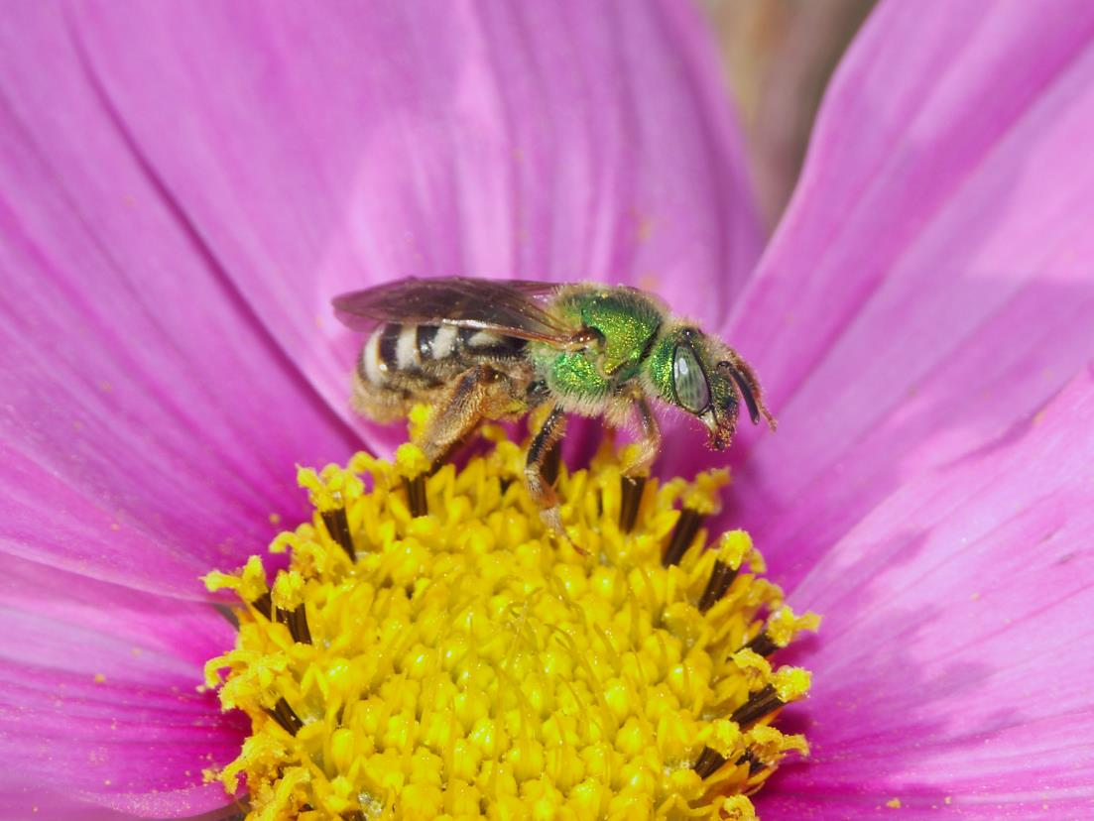
Native Bee Diversity
Photo: Metallic green sweat bee (Mace Vaughan)
Notes:
Bees come in a range of colors, from dull black to bright metallic green or blue. They may have markings in red, orange, white, black, brown, and yellow.

Slide 27
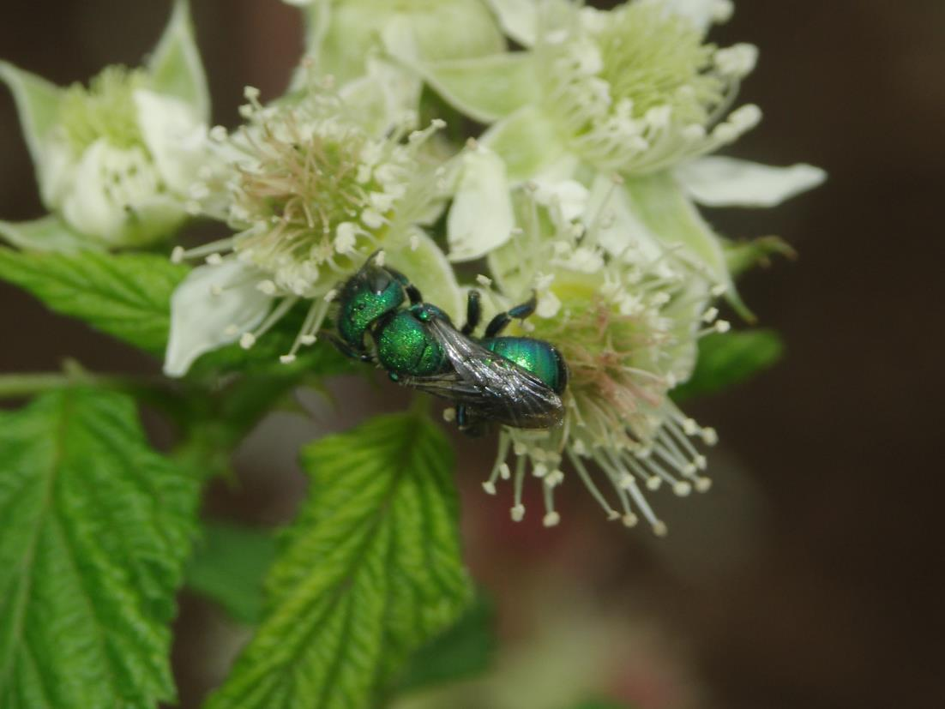
Native Bee Diversity
Photo: Green leafcutter bee (Xerces Society / Mace Vaughan)
Notes:
Some bees don’t look like bees: tiny, not very fuzzy, not yellow and black.

Slide 28
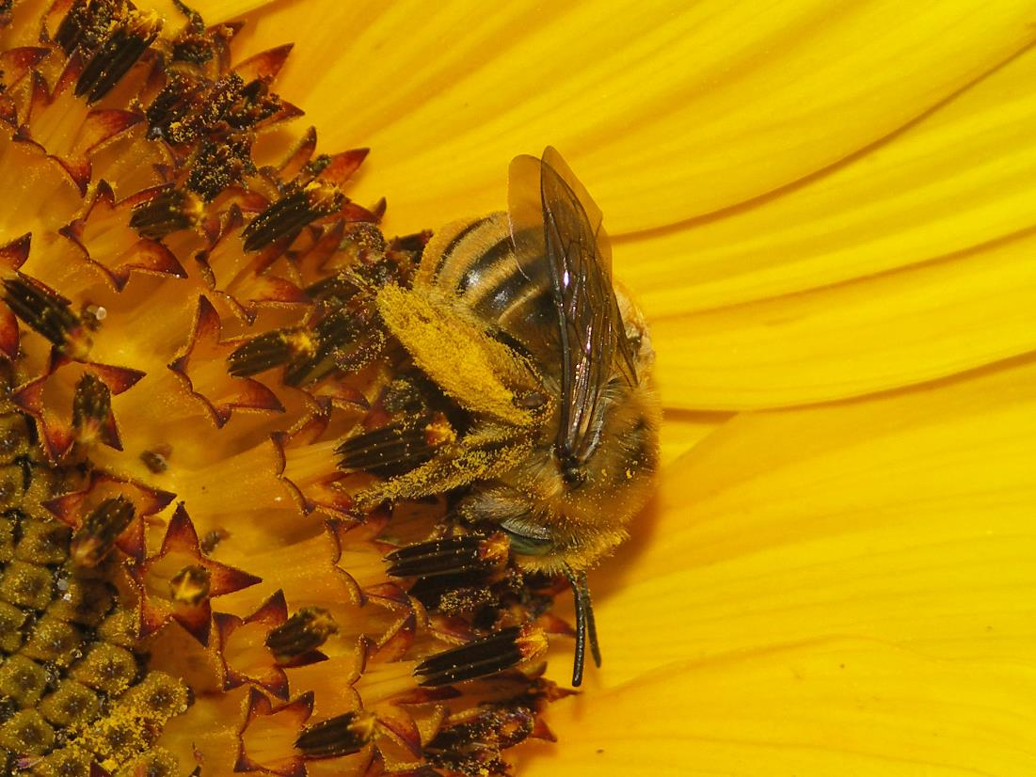
Native Bee Diversity
Photo: Long-horned bee (female) (Mace Vaughan)
Notes:
Bees often have a structure for carrying pollen.
Some, like honey bees and bumble bees have a pollen basket, a bare patch of leg surrounded by long, stiff, in-curving hairs into which a lump of pollen moistened with nectar is packed.
Most bees have a pollen brush that carries dry pollen that gets stuck to the feather-like bristles.

Slide 29
Native Bee Diversity
Photo: USGS Bee Inventory and Monitoring Lab
Notes:
A bee has five eyes – two large compound eyes are used for vision, much like our two eyes. They can see most of the light spectrum we can, plus UV colors, although red doesn’t show up well to some species.
On top of a bee’s head are three small simple eyes called “ocelli” that detect light and dark.

Slide 30
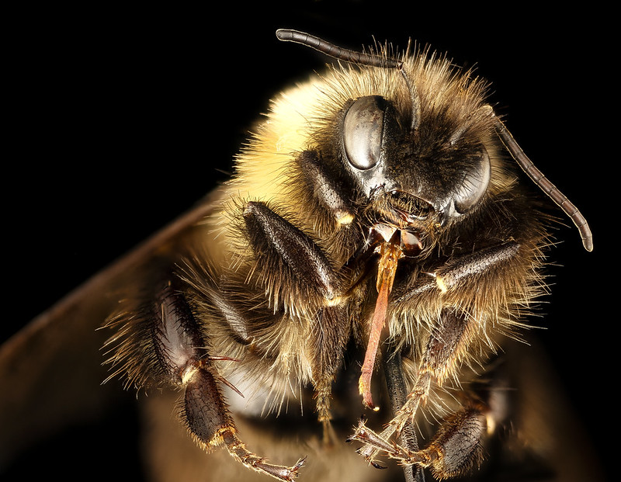
Native Bee Diversity
Photo: USGS Bee Inventory and Monitoring Lab
Notes:
Different species of bees have tongues of different lengths. The long tongue of this bumble bee allows it to reach nectar inside deep flowers. Some bees with short tongues can only reach the nectar of shallow flowers.

Slide 31
Wasps are Not Bees
Photo: Matthew Shepherd
Notes:
People often say – “It was a bee that wrecked my picnic” when in fact it was a wasp! Shown here is a yellow jacket. Wasps are important for eating pests in your garden, as they are carnivores. However, some wasps, like yellow jackets can be aggressive. Many wasps are not aggressive.

Slide 32
Natural History
Photo: Rollin Coville

Slide 33
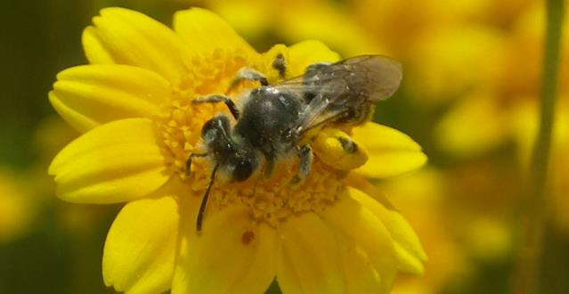
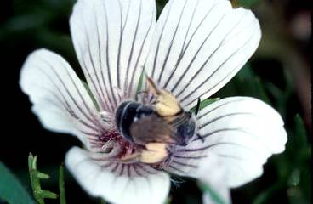
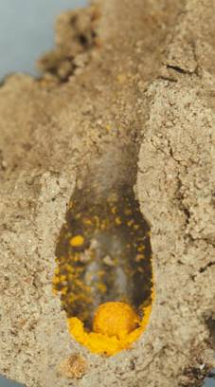
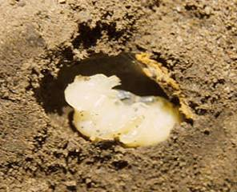
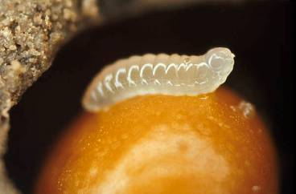
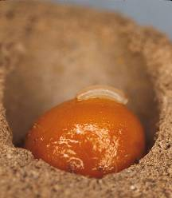
Solitary Bee Life Cycle
Up to a year to develop before emerging to spend a few weeks as an adult.
Mining bee
Photos: Xerces Society/Mace Vaughan; Dennis Briggs (3); Robbin Thorp.
Notes:
Over 90% of native bees are solitary.
This is an example of what a typical solitary life cycle looks like. Most of our native bees are solitary and generally live for about 1 year. The adult stage typically lasts 3-4 weeks. The offspring typically remain in the nest for about 11 months, growing through the egg, larva, and pupa stages. The female will mate once and then spend her time creating and provisioning a nest to lay her eggs. A nest may have 1-10 cells depending on species and the cell may be formed or lined with waxy or cellophane-like secretions, pieces of leaf or petal, soil, or chewed up wood. Before she closes each cell, the bee provisions it with food for her offspring. She mixes together the nectar and pollen to form a loaf (or bee bread) inside the brood cell. She then lays an egg in the cells, usually on the loaf, and seals the cell. When she has completed and sealed all the cells in her nest, the bee will cap the nest entrance and leave. A female solitary bee may lay up to 20-30 eggs in her life. Eggs resemble a tiny white sausage. 1-3 weeks later the egg hatches and a white, soft-bodied, grub-like larva emerges. Feeding on the bee bread, the larva grows rapidly for 6-8 weeks before changing into a pupa. During the dormant pupal stage, 8-9 months, the bee transforms within a protective cocoon into its adult form. When it emerges, the adult bee is fully grown, ready to mate and continue the cycle.

Slide 34
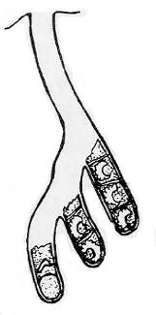
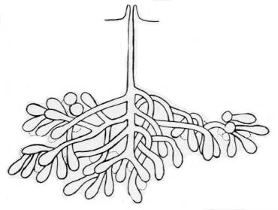
Bee Needs: Access to Soil
Roughly 70% of native bee species are ground-nesting
Resemble ant-nests from above ground
Conserve sandy soil, bare ground
Photo: Xerces Society/Matthew Shepherd.
Drawings from Stephen, Bohart, and Torchio, 1967
Notes:
Roughly 70% of native bee species nest underground.
Resemble ant-nests from above ground
May be found in turf, more often on bare, exposed ground
Sandy to loam soils preferred, but some will nest in clay too
Look for them on south-facing slopes
You can promote ground nesting sites by leaving areas undisturbed with patches of bare soil. Relatively undisturbed conditions will allow bee nests to become well-established, and they may be enhanced with the addition of key native flowering plants and/or nest site materials.
Managing nesting sites for ground-nesting species centers on leaving some undisturbed bare ground. In general, it is important that ground nest sites receive direct sunlight and that bare soil – even very small patches – is accessible among the plants. This might mean trimming back bushes or trees from time to time and keeping thatch, weeds, grass, or moss from becoming too dense and blocking bee access to the soil below. Other management techniques might include spot herbicide treatments, fire, and haying. Clippings or dead plant material should be mostly removed from the areas of sites and site management should occur in the fall when adult bees are not present.

Slide 35
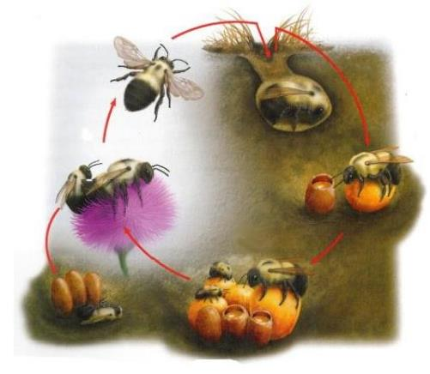
Bumble Bee Life Cycle
Winter: Hibernating queen
Fall: Mated queens seek overwintering sites, founding queen dies
Spring: Queen establishes nest and lays eggs
Early Fall: Males leave nest, then new queens leave to find a mate
Early Summer: Worker females help grow the colony
After mating, males die
Summer: Colony peak
Illustration: David Wysotski
Notes:
Bumble Bees are social but also ground nesters.
Unlike honey bees which exist in perennial colonies, bumble bees form annual colonies formed in the spring by a solitary queen.
The queen creates the first few brood cells from wax, and then provisions them with pollen and nectar and lays eggs. It will take four to five weeks for the first eggs she lays to emerge as adult bees; these bees become workers, taking on the tasks of foraging and helping the queen tend the growing number of brood cells. Depending on their role in the nest, workers may live for one to two months, by which time there will be more workers to replace them. The queen will continue to lay eggs, and the colony will grow steadily through the summer. At the end of summer, new queens and drones will emerge and mate. Because bumble bees have an annual life cycle, and generally only occupy nest sites for one year. Repeated use of the same nest site would happen only by chance, as overwintering queens do not spend the winter in the nest in which they were born. Because of this, we encourage folks that find nest sites near their home to try to make space for the bumble bees during the season, rather than attempt to move or exterminate them. Understanding the life cycle of a typical bumble bee colony is the first step in understanding their unique habitat needs.

Slide 36
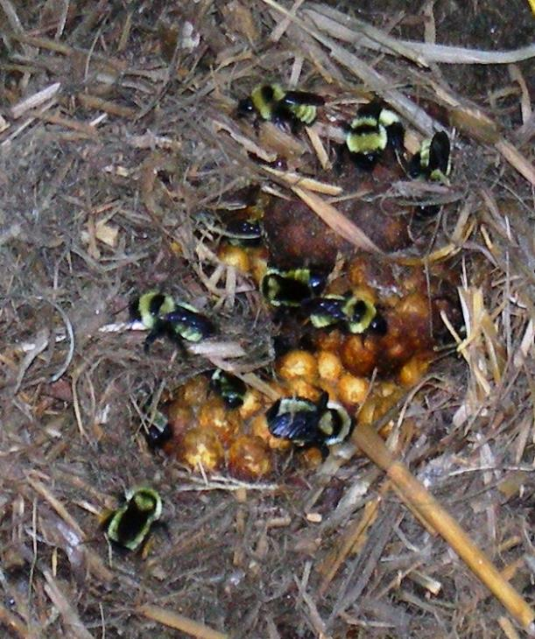
Habitat Needs: Untidy Areas
Bumble bees nest in existing cavities such as old rodent holes
Don’t tidy all areas
Have long grass and overgrown places
These places can also provide winter shelter for butterflies
Photos: Matthew Shepherd; Bonnie Carruthers
Notes:
Bumble bees need a cavity in which to build their nest. The queens are opportunists, looking for any suitably sized cavity. Sometimes this is above ground, such as in hollow trees, abandoned bird nests, rock walls, or under a tussock of grass, but they mostly nest underground. An abandoned rodent hole is a favorite, as this space is warm and already lined with fur.

Slide 37
Bee Needs: Dead Trees and Branches
Roughly 30% of native bee species are tunnel-nesting
Keep dead trees
Don’t trim all dead twigs and branches
Photo: Xerces Society/Matthew Shepherd.
Drawings from Stephen, Bohart, and Torchio, 1967
Notes:
About 30% of our native bees nest as solitary individuals in wood tunnels, usually hollow stems, or the abandoned beetle borer holes found in dead trees, or stumps.

Slide 38
Bee Needs: Nest Materials
Some species collect leaf pieces, resin, soil, etc. for constructing nest cells
Photo: Clay Bolt
Notes:
Different bee species need different materials to construct brood cells and seal their nests, including pieces of leaf or petal, mud, fine pebbles, sawdust, or tree resin. Damp ground or mud puddles and a variety of native plants near the nests will be important for construction material (mud, leaves, petals) and will benefit butterflies that drink from puddles. Beetle-riddled snags should be left for mason and leafcutter bees. Maintain existing plants or grow additional plants that provide nesting habitat for bees. Plants with stems that bees utilize as tunnel nests include (Vaughan 2015): Box elder (Acer negundo), Agave (Agave spp.), Sunflower (Helianthus spp.), Sumac (Rhus spp.), Wildrose (Rosa spp.), Raspberry, blackberry (Rubus spp.), Elderberry (Sambucus spp.), Cup plant (Silphium perfoliatum), Snowberry (Symphoricarpos spp.), Ironwood (Vernonia spp.), and Yucca (Yucca spp.).

Slide 39
Habitat Needs: Flowers
Drink nectar from any accessible flower
May be more particular about where they collect pollen
Photo: Matthew Shepherd
Notes:
Bloom throughout the season and native where possible.

Slide 40
Threats
Photo: Matthew Shepherd

Slide 41
Habitat Loss
Photo: Matthew Shepherd
Notes:
Habitat loss is a key driver of pollinator declines, and can take several forms.
One component of loss is habitat conversion – for example development, intensive agriculture, or landscaping that is not pollinator-friendly. Another part is pesticide contamination of areas that could otherwise be pollinator habitat. A third factor in habitat loss is declines of key plant species that pollinators depend on, like milkweed that monarchs need to reproduce.

Slide 42
Habitat Loss
Photos: Matthew Shepherd; heipei, Flickr
Notes:
These are examples of common urban areas where pollinator habitat is lost. This may be overlooked as habitat loss.

Slide 43
Pesticides
Photo: Xerces Society/Matthew Shepherd
Notes:
Pesticide is an umbrella term including insecticides, fungicides, and herbicides, as well as rodenticides and even antimicrobial products. The term is often misused as synonymous with insecticides but it is a much broader term. The pesticides we are most concerned about for pollinators are insecticides (insects), fungicides (fungi), and herbicides (plants).
Major threat! This photo shows sample jars with dead bees in them. During Pollinator Week in 2013, near Portland, OR there was an incident. Some trees were treated with insecticides in a parking lot to control aphids. The pesticides got through the sap and into the flowers, killing approximately 50,000 bumble bees over the period of two weeks. These samples indicated that the pesticide caused these bees to die. The pesticides were applied legally. This story underlines the importance of avoiding pesticide use. The good news is that those pesticides can no longer be used on linden trees in the city.

Slide 44
Pesticides
Photo: Matthew Shepherd
Notes:
When we think about pesticides, we often think about agricultural areas, but they are commonly used in urban areas as well. In our communities, pesticides are often used for cosmetic reasons to maintain manicured landscapes. Eliminating this cosmetic pesticide use is a simple step to ensure a healthier environment for pollinators, people, and other species. Another consideration for urban pesticide use is that all the impervious surfaces allow pesticides to wash off and easily find their way into storm drains and waterways, so limiting urban pesticides is a great step for water quality.

Slide 45
Climate Change
Photo: John Weiss, Flickr
Notes:
You might think – what can I do about climate change? It is a huge issue! But you can help.

Slide 46
Conservation
Photo: Eric Lee-Mäder
Notes:
Providing habitat can make a difference for pollinators. On a larger scale, our landscape can become more resilient.

Slide 47
Beekeeping ≠ Bee Conservation
There are lots of good reasons for keeping honey bees
But bee conservation is not one of them
Photo: Thien Gretchen, Flickr
Notes:
Conservation is providing habitat and avoiding using pesticides. An analogy – to save song birds, you wouldn’t keep chickens. Honey bees are similar to livestock.

Slide 48
Provide Habitat
Support the entire life cycle
Bees need:
Secure nest sites
Flowers for foraging
Pesticide-free environment
Photo: Matthew Shepherd
Notes:
Steps you can take to support bees and other pollinators include providing habitat and supporting the entire life cycle.

Slide 49
Partial Habitats
Source: Westrich 1996
Notes:
Bees don’t need large areas of habitat. Even one plant can provide habitat. They also don’t need nesting and foraging areas to be right next to each other. Think about what your neighbors have in their yard, do you have large trees close by? What is near your side walk? Bioswale?

Slide 50
Bee’s-eye View of a Neighborhood
Graphic: Xerces Society / Sara Morris
Notes:
The dotted line is where a bee might travel.

Slide 51
Unnatural Areas
Partial habitats in urban and suburban areas
Photos: Matthew Shepherd (7); Rebecca Tonietto
Notes:
Roadsides, eco roofs, bioswales, schools, parks, powerline passes, dead trees and snags, and our gardens!

Slide 52
Bee Nest Sites
Retain Natural or Existing
Snags
Shrubs with hollow stems
Bare ground
Photos: Xerces Society/Matthew Shepherd
Notes:
To provide habitat for bees to nest in make sure to leave bare ground, hollow tunnels, and dead trees. It doesn’t have to be tidy.

Slide 53
Ground Nests
Bare ground doesn’t need to be a large area
Photo: Matthew Shepherd
Notes:
The areas don’t need to be large. This picture shows an area about 8 - 10 inches wide between a rocky wall and a driveway. There are holes under the rock leading to nests. This is great habitat in a small area.

Slide 54
Nest Blocks
Make your own artificial snags
Drill holes
3/16” to 3/8” diameter
4” to 6” deep
Hollow stems
Bamboo
Common reed
Photos: Matthew Shepherd
Notes:
Easy to provide, anything with a tunnel hole. Drill holes in a block or use bamboo.
The larger the hole, the deeper they need to be. Remember: the series of brood cells, the last cells are males, but it is only the cells in the back that are females. The shorter the hole, the fewer females and we want a lot of females.
Nest blocks, or bundles of tubes or stems, should be mounted in a location that receives morning sun, but has some protection from the extreme midday summer heat. Generally, the nest entrances should face southeast, so that the bees can be warmed as quickly as possible in the morning. Nests also should be erected at least 4' above the ground to raise them above cool moist air that may pool at night, and they should be fastened securely so that they do not move in the wind.
Blocks need to be cleaned out every season to prevent the spread of disease.

Slide 55
Nest Blocks
Tunnel nests work!
Photos: Mace Vaughan; Matthew Shepherd
Notes:
Mason bees will have mud at the end, leaf cutter bees will have leaves at the end.

Slide 56
Nest Blocks
Help more than just bees
Notes:
The grass sticking out – is a grass carrying wasp. It is not a threat to people, they are gentle solitary wasps. They will however prey on pests in your yard!

Slide 57
Bumble Bee Nests
Nice project, but of limited value
Better to ensure adequate untidy areas!
Photos: Xerces Society/Matthew Shepherd
Notes:
8 x 8 inches. Put in some soft bedding with pipe as the entrance. Bury it if you want. Only 1 out of 5 will ever be occupied.
The best way to help bumble bees it to have untidy areas and old rodent holes, leave alone.

Slide 58
Forage Patches
Plants bloom everywhere, but not all flowers will help bees and butterflies
Retain existing flower patches
Create new patches
Locally native plants are better
Photo: Mace Vaughan
Notes:
Diversity of different bees, with different emergence times and flight periods. Social bees like bumble bees need a consistent source of food throughout the season for the colony to build. So, having something in bloom consistently from very early spring until the fall is critical to support pollinator abundance and diversity.
Locally native plants are better.

Slide 59
Choice of Plants
Color
Diversity
Bloom period
Native species
Drought tolerance
Landscape context
Photo: Xerces Society/Mace Vaughan
Notes:
Bees don’t see red – white, yellow, purple are great. They see ultraviolet. Green is the same as red to them!
Diversity of flowers is good for a diversity of bees. Three species of flower blooming at all times from late winter to late fall. Some parts of the country all year. Some places will have a shorter season.
Native plants have been shown to support a greater diversity and abundance of native bees.
With climate change, drought tolerance is important.
With landscape context, smaller spaces can still make a difference. Think about the habitat around you, even local parks. How can you fill the blooming gaps. If you were a bee flying around, what would you need?

Slide 60
Native is Best
Provide bloom from late-winter to late-fall
Photos: Matthew Shepherd
Notes:
For this reason, it is important that pollinator habitat contains a diversity of native plants that provide a succession of bloom throughout the growing season.
Use local examples!

Slide 61
Garden Plants
Garden plants are OK in a formal landscape, when chosen carefully
Photos: Matthew Shepherd
Notes:
Garden plants – get as close to native as possible.
Neo-natives are from the same country but from a different region.

Slide 62
“Cultivar Conundrum”
Some modern varieties and cultivars have lost their ability to produce pollen and/or nectar
Avoid double-flowered varieties
Photo: Matthew Shepherd
Notes:
When you go to buy flowers, which ones have bees on them? Pick those ones.

Slide 63
Lawns
Sow an ecolawn
Apply benign neglect
Photo: Matthew Shepherd
Notes:
Doesn’t have to be an ecolawn, but ‘weeds’ in a lawn – such as clover, are great for bees.

Slide 64
Pesticides
Avoid using pesticides
If you must use them:
Minimize their use
Read guidance carefully
But be warned:
Even when label instructions are followed, there is limited protection for native bees.
Photo: Xerces Society/Matthew Shepherd
Notes:
Pesticides are a huge issue. Xerces has other webinars specifically about pesticides on their YouTube channel.

Slide 65
Displaced Problem
Plants treated at the nursery with systemic insecticides such as neonicotinoids will carry those with them.
Some neonicotinoids will remain in the plant for months or years.
Photo: Matthew Shepherd
Notes:
When you go to a nursery, ASK if they have been treated. If they don’t know, don’t buy them.

Slide 66
Use Alternatives
Beneficial predators and parasitoids
Pollinator habitat will also support many other helpful insects
Photo: Adam Varenhorst
Notes:
A diversity of plants and untidy areas in your yard will bring in beneficial insects.

Slide 67
Bring Back the Pollinators
BringBackThePollinators.org
Sign the Pollinator Protection Pledge
to follow the four principles:
Grow pollinator-friendly flowers
Provide nests & egg-laying sites
Avoid using pesticides
Share the word
Find Information
Photo: Matthew Shepherd
Notes:
Xerces campaign – sign up today!
The sign can be purchased through Xerces’ gift catalog – or create your own sign!

Slide 68
Bee City USA
Bee City USA fosters ongoing dialogue in urban areas to raise awareness of the role pollinators play in our communities and what each of us can do to provide them with healthy habitat.
A Bee City USA affiliate commits to create habitat, reduce pesticide use, and host outreach activities.
Driven by local desire to help pollinators.
beecityusa.org
Notes:
Want to go beyond your garden and get your city to be a Bee City? Visit the website for more information.

Slide 69
Community Science
Xerces Society
Bumble Bee Watch
PNW Bumble Bee Atlas
Nebraska Bumble Bee Atlas
Western Monarch Milkweed Mapper
Photo: Xerces Society / Matthew Shepherd
Notes:
Get involved with community science.
Add in local orgs that are more regional.

Slide 70
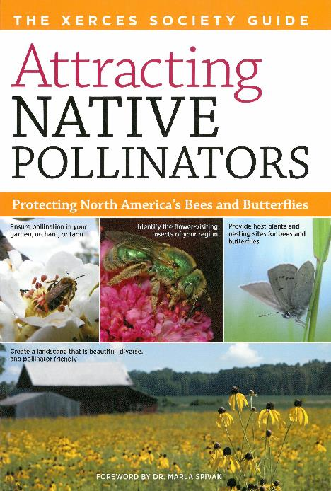
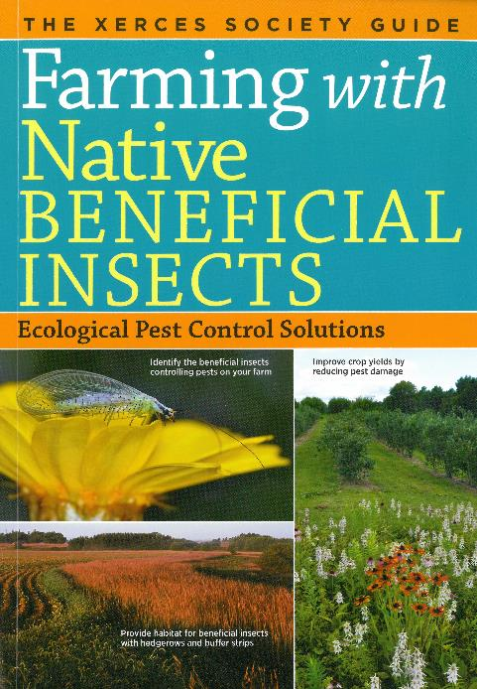
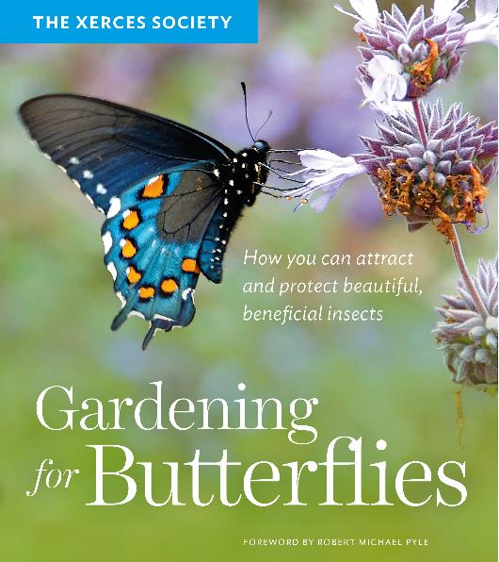
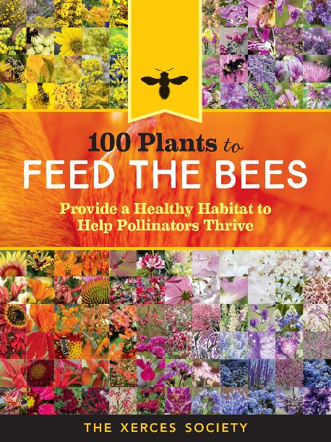
Books by the Xerces Society
Notes:
Xerces’ books can be found at Powells Bookstore and on Amazon.

Slide 71
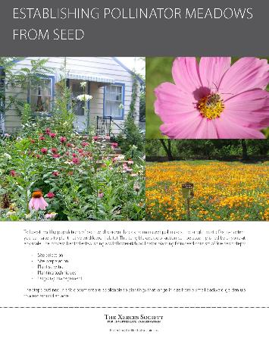
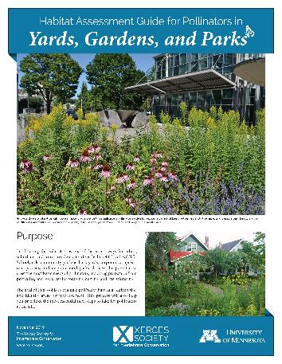
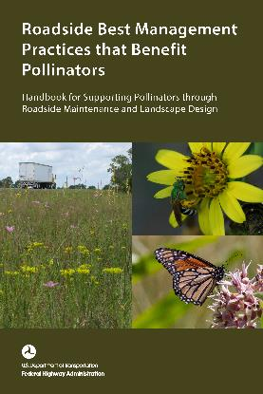
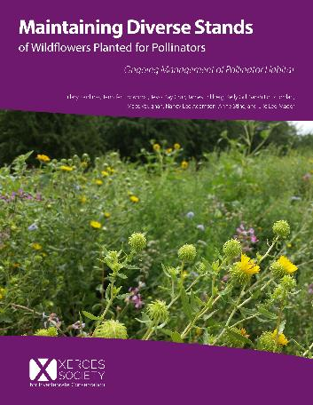
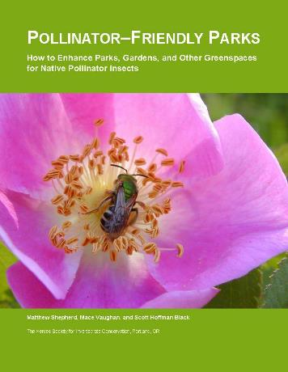
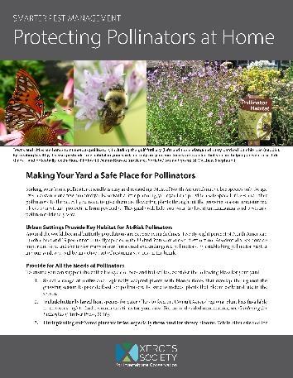
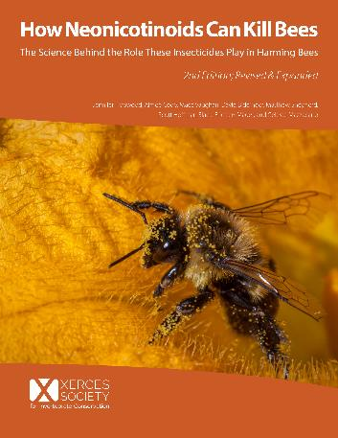
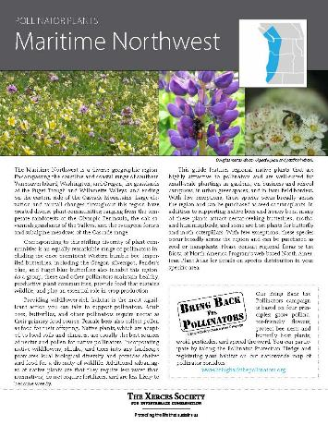
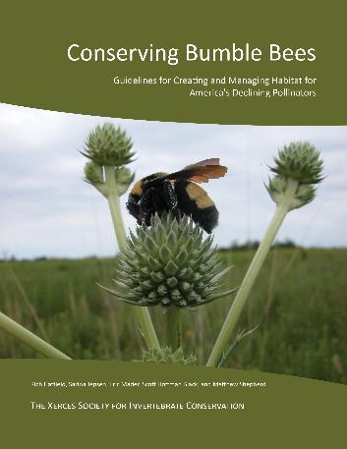
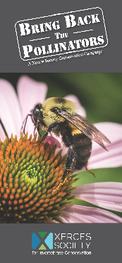
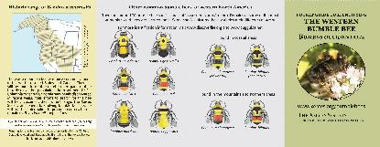
Download from xerces.org
Fact sheets & brochures Guidelines & reports
Notes:
Lots of free resources.

Slide 72
YouTube
Notes:
Subscribe and see other webinars!

Slide 73
Connect
@xercessociety
@beecityusa
Notes:
Follow Xerces and Bee City USA on social media.

Slide 74
Thank you!
Any questions?
Photo: Matthew Shepherd

